Slide 1

Elastic Stack at RAL
Greg Corbett, James Adams
Scientific Computing Department
STFC Rutherford Appleton Laboratory

Slide 2
Elastic Stack at RAL
Why we have an Elastic Stack
Elastic Stack setup
Combining data from multiple sources

Slide 3
Why we have an Elastic Stack
Original use case
Monitoring/event logging for CASTOR
One day generated ~33 million events
Now 12+ services use it
For monitoring, audit log storage and metric gathering
One day generates ~200 million events
Notes:
Since 2013
i.e.
CEPH cluster at RAL was writing 5million events every hour for a week in early Feb
The STFC Cloud writing 15.5 million events a day

Slide 4
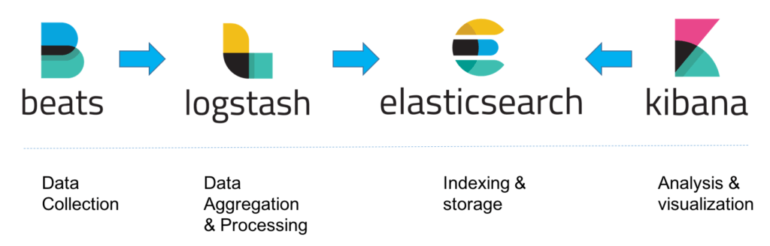
Elastic Stack setup
Image source: https://logz.io/learn/complete-guide-elk-stack/
Notes:
We use filebeat as our beat, installed via RPM

Slide 5



Logstash
Host A
Ingestor node
Logstash pipelines run in containers, one container per service
Host B
Host C
Notes:
Each service has a containerized Logstash process on each ingestor node with it’s own pipeline/configuration.
Makes it easy to change individual pipeline without the need to restart all pipelines
Makes it harder for one service to bring down another's pipeline
Two ingestor nodes for resiliency

Slide 6
Elasticsearch
Optimized for ingestion, trading off refresh rate for throughput
Ingesting thousands of events per second as opposed to a handful of searches every few minutes
3 shards per index, keeps number of shards per node to less than 20 per GB of heap (~600)
We use Readonly REST to manage ACLs and enforce HTTPS

Slide 7



Elasticsearch and Kibana
Elasticsearch node
Elasticsearch node
Elasticsearch node
HAProxy
Readonly REST
HAProxy
Notes:
Elasticsearch has no concept of security (unless $$$)
Cluster would to be read/write-able to anyone behind STFC’s firewall via HTTP
We use the free version of Readonly REST to implement ACLs and only allow HTTPS connections
All ACLs are currently host based
Future ACLs will integrate with LDAP
“Read only” users interact with ElasticSearch via a load balancer, don’t see individual nodes in the cluster
An instance of Kibana on every Elasticsearch node. Again, users interact via a load balancer, don’t see individual nodes in the cluster
Kibana can write it’s monitoring data and visualisations to the cluster

Slide 8

Data from Multiple Sources
Webserver
HAProxy
Webserver logs
HAProxy logs
Webserver
pipeline
HAProxy pipeline
Notes:
For web services behind a load balancer,
the load balancer see the client details
the service sees details like user, endpoint accessed, etc
Two event recorded, neither have the full picture
Can we link these two events?

Slide 9
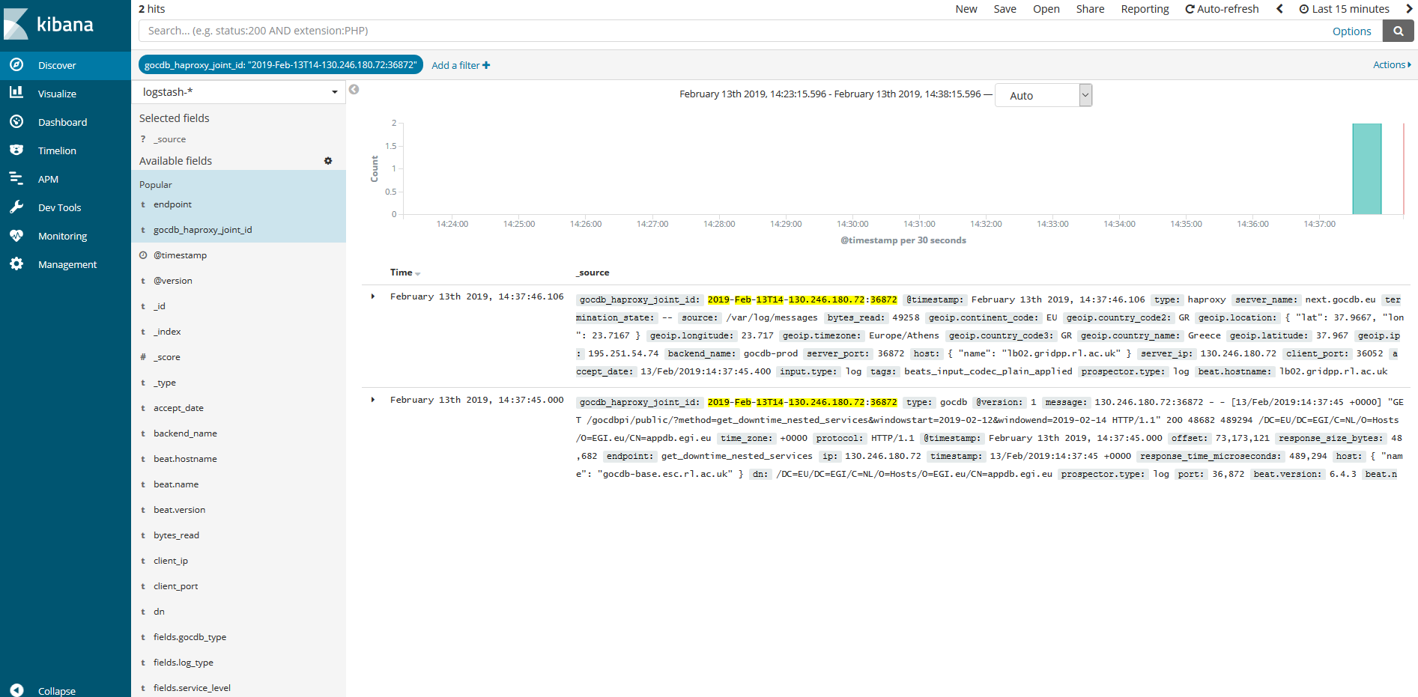
Data from Multiple Sources
Notes:
Both events define a joint id based on time and the load balancer IP/port number.
This joint id can then be used to pair up events if needed
Stopped short of combining the two events into one

Slide 10
Questions?

Slide 11
Further Reading
Scaling Elasticsearch
https://indico.cern.ch/event/391769/contributions/1827758/attachments/784181/1074960/2015-06-02-hepsysman-jrha-elasticsearch-scaling.pdf
How many shards should I have in my Elasticsearch cluster?
https://www.elastic.co/blog/how-many-shards-should-i-have-in-my-elasticsearch-cluster

